Slide 1

HOMEWORK4 – PROJECT3
Zeynep Gizem ÇETİNCİ
B1605.010034

Slide 2
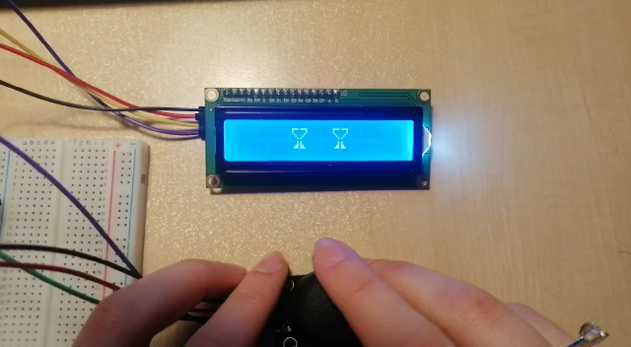
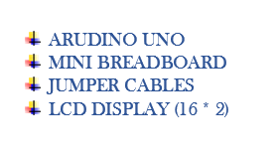
MAKE ARDUINO LCD GAME AND ANIMATION

Slide 3
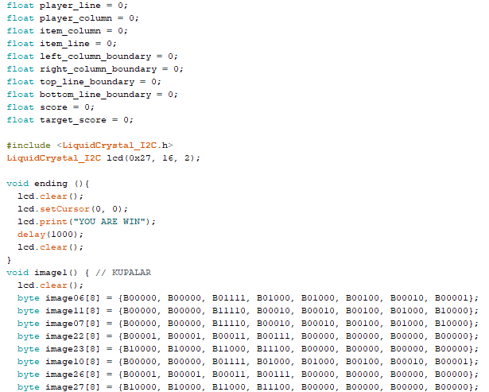
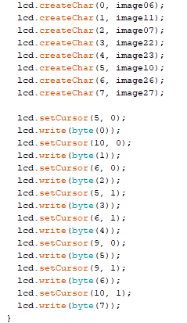
MAKE ARDUINO LCD GAME AND ANIMATION

Slide 4
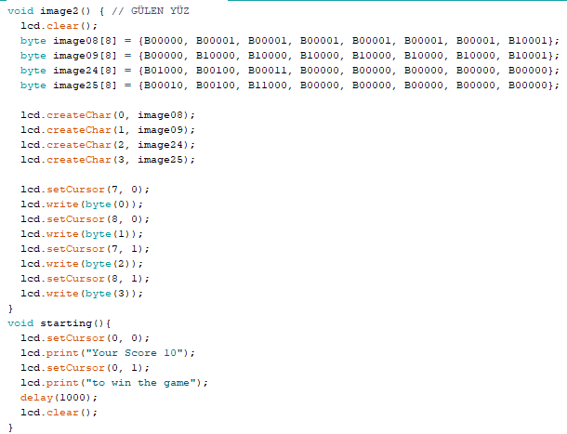
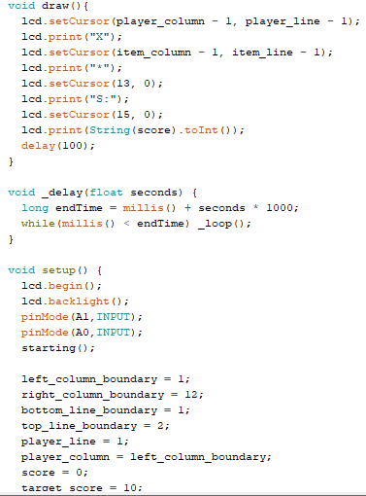
MAKE ARDUINO LCD GAME AND ANIMATION

Slide 5
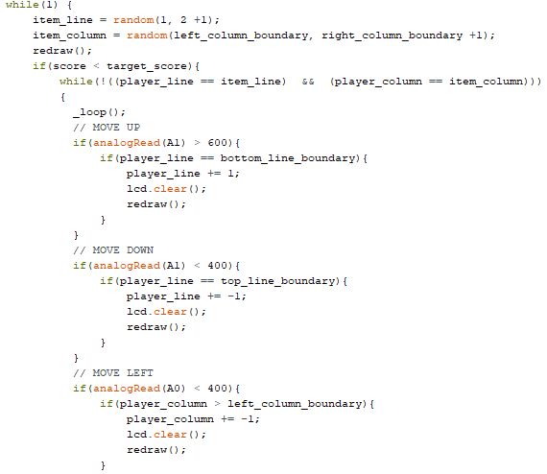
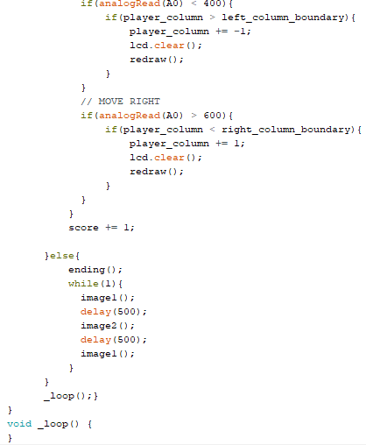
MAKE ARDUINO LCD GAME AND ANIMATION

